Slide 1
Economics I
Week #9

Slide 2
Topics of Week #9
What is price discrimination?
How is price discrimination practiced?
Examples of Price Discrimination
Importance of Price Discrimination*
Conditions of Price Discrimination *
Arbitrage
One Price versus Price Discrimination (Third-Degree)*
First-Degree (Perfect) Price Discrimination*
Comparing Market Structures*
Welfare Effects of Price Discrimination *
"*" Indicates the most important topics.
Mateer and Coppock: Chapter #11

Slide 3
Previously
While competitive markets generally bring about welfare-enhancing outcomes for society, monopolies often do the opposite.
Perfectly competitive markets and monopoly are market structures at opposite extremes.
Like perfectly competitive firms, a monopoly tries to maximize its profits.
From an efficiency standpoint, the monopolist charges too much and produces too little.

Slide 4
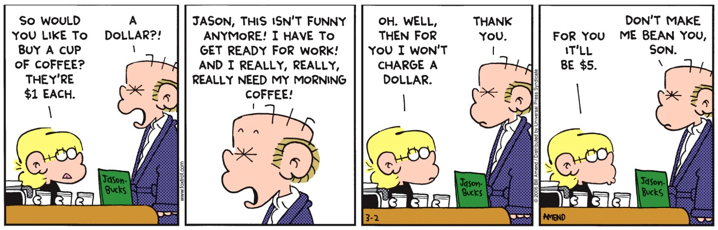

Slide 5
Economics in Ally Bank Commercial
"All Bank Commercial"
"Would You Like a Pony?"
"Even kids know it is not right to hold out on someone."
Notes:
"Economics in the Media" Slide
Lecture tip:
The clip mentioned on the slide can be found in the Interactive Instructor's Guide. Access the direct link by clicking the icon in the PowerPoint above.
You can follow up this clip by asking students:
How does Ally Bank discriminate among its customers?

Slide 6
Big Questions
What is price discrimination?
Occurs when a firm sells the same good at different prices to different groups of customers.
How is price discrimination practiced?
To practice price discrimination, a firm must be a price maker.
It must have some market power before it can charge more than one price.
A downward-sloping demand curve is indicative of market power.
This is something you won't see in perfectly competitive markets.
Both monopolies and non-monopoly companies use price discrimination to earn higher profits.
In this course for simplicity we will use monopolistic firms to analyze the effect of price discrimination.

Slide 7
Price Discrimination
Question for the day:
Is price discrimination legal in the United States and in Turkey?
Generally, yes.
Clayton Act and Robinson Patman Act.
Price discrimination is illegal if there is intent to harm rivals.
Further questions:
Who pays in-state tuition?
Who pays out-of-state tuition?
Has anyone ever used a coupon?
Has anyone ever received a student discount?
Those are all examples of (legal) price discrimination!
Notes:
Lecture tip:
Point out that the word "discrimination" is not meant to be pejorative, as in "racial discrimination" or "gender discrimination."
Make sure to emphasize the point about differences in costs.
Price discrimination is beneficial (it increases social welfare), since it allows more consumers to purchase the good or service.
On legality:
Generally, yes.
You could follow up answering the question of legality by discussing the Clayton Act and Robinson Patman Act.
Price discrimination is illegal if there is intent to harm rivals.
A more advanced example:
If you follow the cost argument, if a service is sold at the same price to two different customers, but the costs of serving them is different, it is another form of price discrimination.
Simple example: a haircut at Hair Cuttery.
The price of a basic haircut and shampoo is the same regardless of sex.
The time to cut a "typical" woman's hair is more than that for a "typical" man's hair.

Slide 8
Price Discrimination
Tuition question:
Did you know that in-state and out-of-state tuition prices are different?
Flown before?
On a flight with 100 passengers, there may have been 100 different prices paid for the flight.
But…
There is no difference in service. There is no difference in the education students get, and all passengers on the flight still arrive at their destination.
Notes:
If we all get the same service (education, flight), why do we get charged different prices?
Who pays more? In- or out-of-state students?

Slide 9
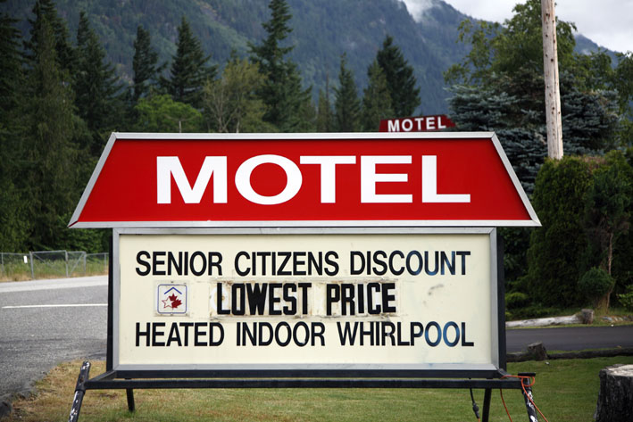
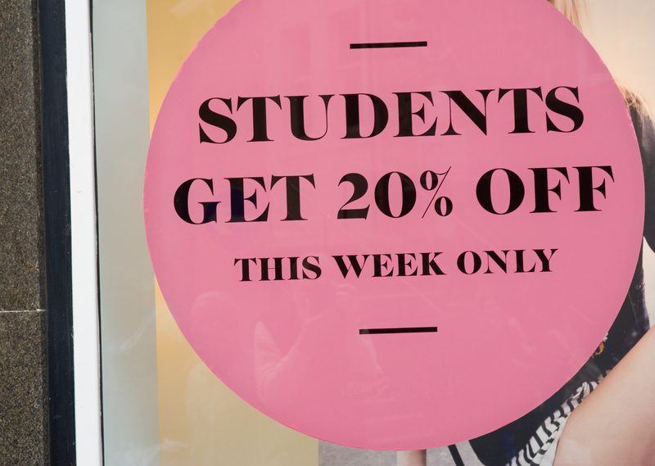
Examples of Price Discrimination
Movie theater tickets, restaurant menus, college tuition, airline reservations, discounts on academic software, and coupons.
College tuition (in state, out of state)
Airline tickets
Movie matinee (weekday afternoon instead of Saturday night)
Inter-temporal price discrimination
Selected "discounts"
Student
Senior citizen
Military
Employee
Notes:
1.When have you paid a price for a good or service, but someone in your party paid a different price for the exact same thing?
2.Will your flight be more expensive if you book it three months ahead of time or one week ahead of time?
3.When is it cheaper to see a movie? Saturday night or Tuesday afternoon?
4.What "types" of consumers usually get discounts?

Slide 10
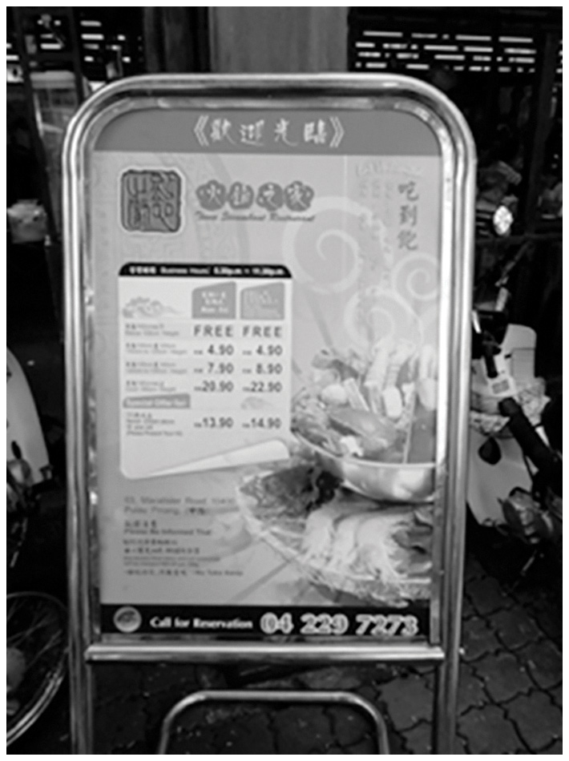
A Strange Example of Price Discrimination
A restaurant in Penang, Malaysia, sets prices segmented according to height, with a discount for the elderly.
A discount for the elderly makes sense, but what about prices which are segmented according to height.
It might be a tax on Western foreigners, who tend to be taller than locals.
Notes:
Real-world example: Price Discrimination Based on Height (See Tip #393)
A discount for the elderly makes sense, but ask students why they think prices are segmented according to height.
The Ultimate Guide suggests that it is a tax on Western foreigners, who tend to be taller than locals.
Ask students whether there is a simpler explanation:
What if the price was for an all-you-can-eat buffet?\
[Wayne Geerling]

Slide 11
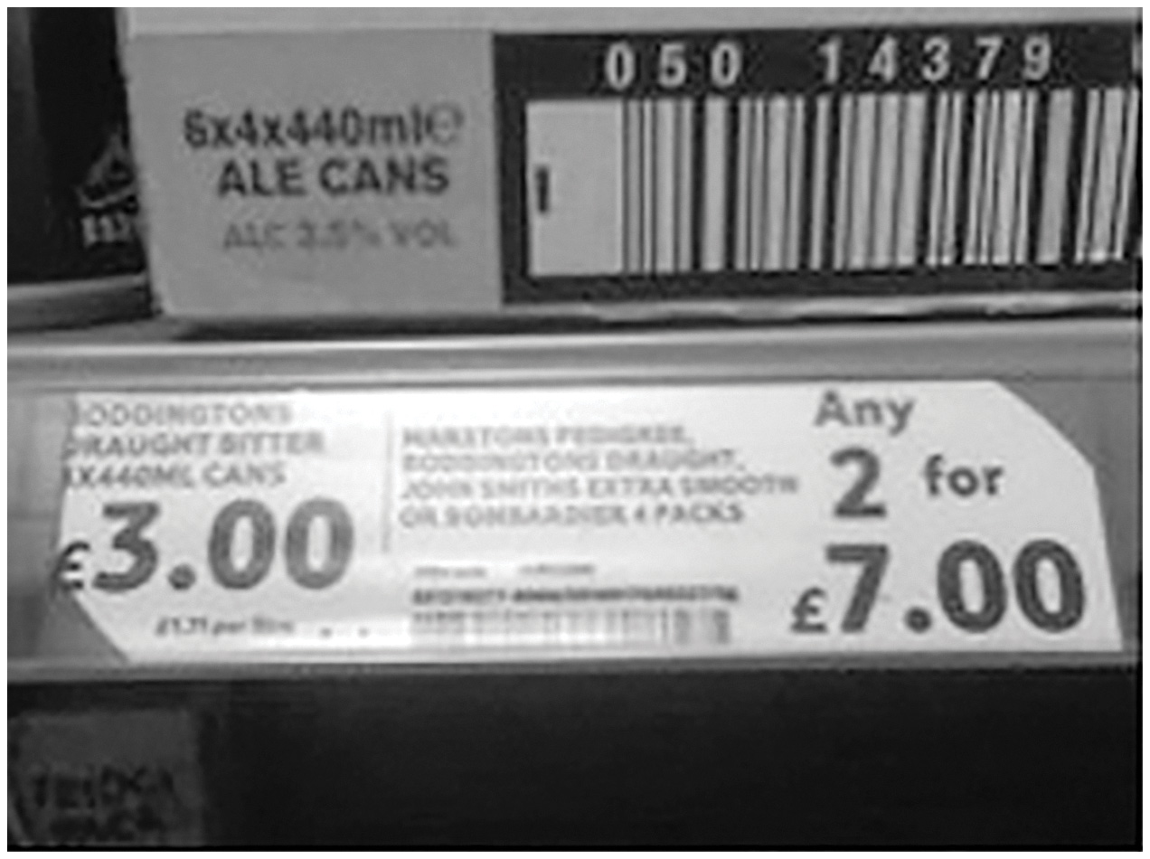
Price Discrimination Gone Wrong
What's wrong in this picture?
Notes:
Real-world example: Price Discrimination Gone Wrong (See Tip #397)
[Wayne Geerling]

Slide 12
Price Discrimination
Price discrimination
A firm sells the same good to different consumers at different prices for reasons NOT associated with cost differences.
Discrimination
Has a negative connotation.
However, in this chapter, we'll see that price discrimination benefits both firms and consumers.
Price discrimination is beneficial since it can allow markets to work more efficiently.
Notes:
Price discrimination is the practice of charging different (marginal) prices to different consumers for the same economic good. These price differences cannot be explained by the difference in marginal cost of making the goods available for the various consumers.

Slide 13
Importance of Price Discrimination
Price discrimination occurs very frequently.
Producer's objective: extract (some of) the consumer surplus.
Different types, classified by Pigou (1920):
First-Degree Price Discrimination (Perfect Price Discrimination): Different prices are charged for the same product to every different consumer.
Second-Degree Price Discrimination: Selling larger quantities of a same product at a lower unit price.
Third-Degree Price Discrimination: Different prices are charged for the same product to different group of consumers.
In this course we will cover only first and third-degree price discriminations assuming the firm we are dealing is a monopoly.

Slide 14
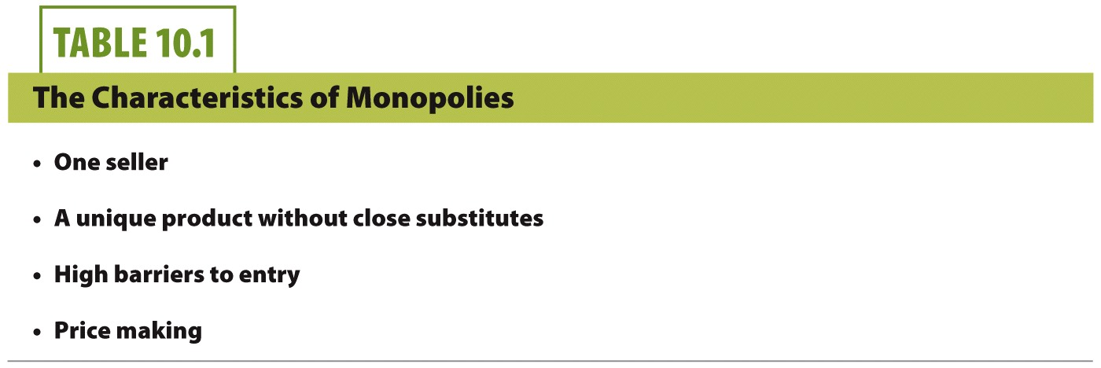
Monopolistic Firm

Slide 15
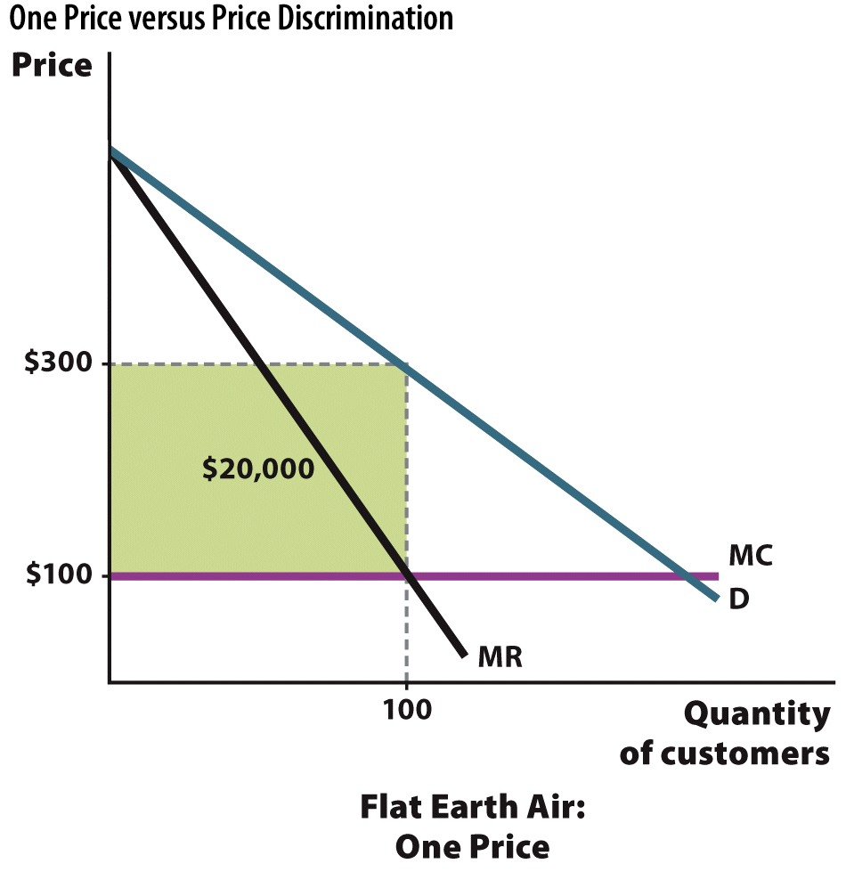
Assume that MC = ATC
Notes:
FIGURE 11.1a One Price versus Price Discrimination
(a) A firm that charges a single price uses MR = MC to earn a profit.

Slide 16
Conditions for Price Discrimination
Two conditions must be met for price discrimination to be successful.
Firm must be able to distinguish groups of buyers with different price elasticities of demand (different willingness to pay).
Firm must prevent resale of the good or service.
Note that the firm must have some market power to price discriminate.
Notes:
Realize that not any firm can price discriminate.
In addition, you may want to mention that the firm also has to have market power to price discriminate. This is something you won't see in competitive markets. A downward-sloping demand curve is indicative of market power.

Slide 17
Distinguishing Groups of Buyers
General rule
Charge higher price to relatively inelastic consumers. Why?
Charge lower price to relative elastic consumers. Why?
How to find these people?
Let the consumers "self-select" into a group.
Offer price discounts at certain times (Sunday movie matinee)
Have consumers show you their group/identity.
Got your student ID? Get student discount!

Slide 18
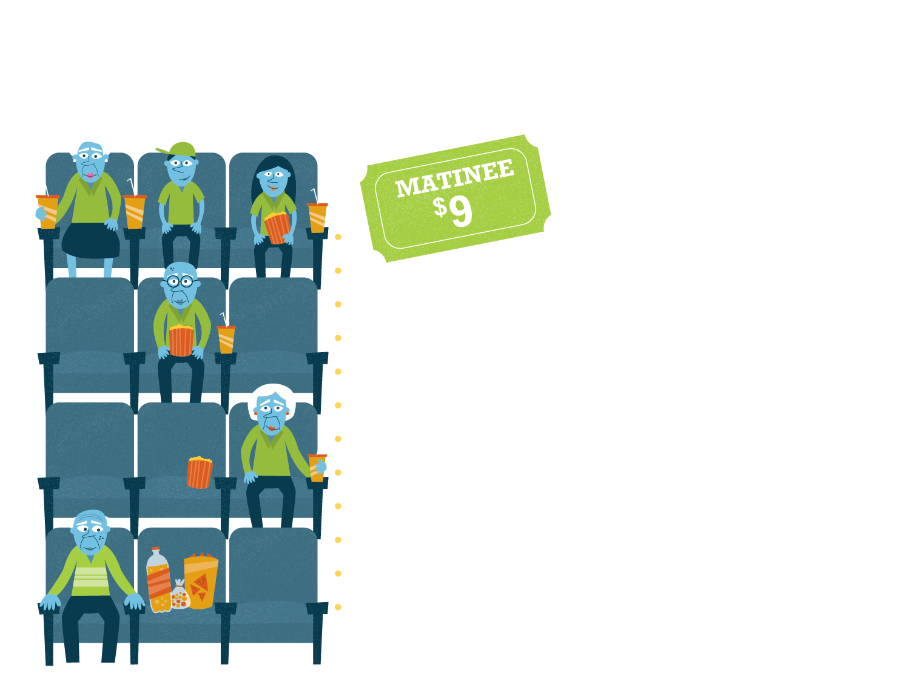
Now Playing: Economics!
SNAPSHOT
Demand for matinees is typically low. These showings attract groups with relatively elastic demand, like families and those on a budget, who decide to attend matinees because of lower prices.
The concession counter also generates profit for the movie theater. The high prices mean that patrons who are price conscious (having relatively elastic demand) skip the counter or smuggle in their own snacks, while those who are more concerned about convenience than price (having relatively inelastic demand) buy snacks at the counter.
Notes:
Have you ever gone to the movies early so you could pay less for tickets? Movie theaters price-discriminate based on the time of the movie and the age of the customer. In order to be able to practice price discrimination, theaters must be able to identify different groups of moviegoers, where each group has a different price elasticity of demand.
REVIEW QUESTIONS
Does price discrimination hurt all consumers? Think about the example of movie theaters as you craft your response.
Suppose your local movie theater is thinking about increasing ticket prices for just the opening day of a blockbuster movie. How would you explain the economics behind this price increase to your friends?

Slide 19
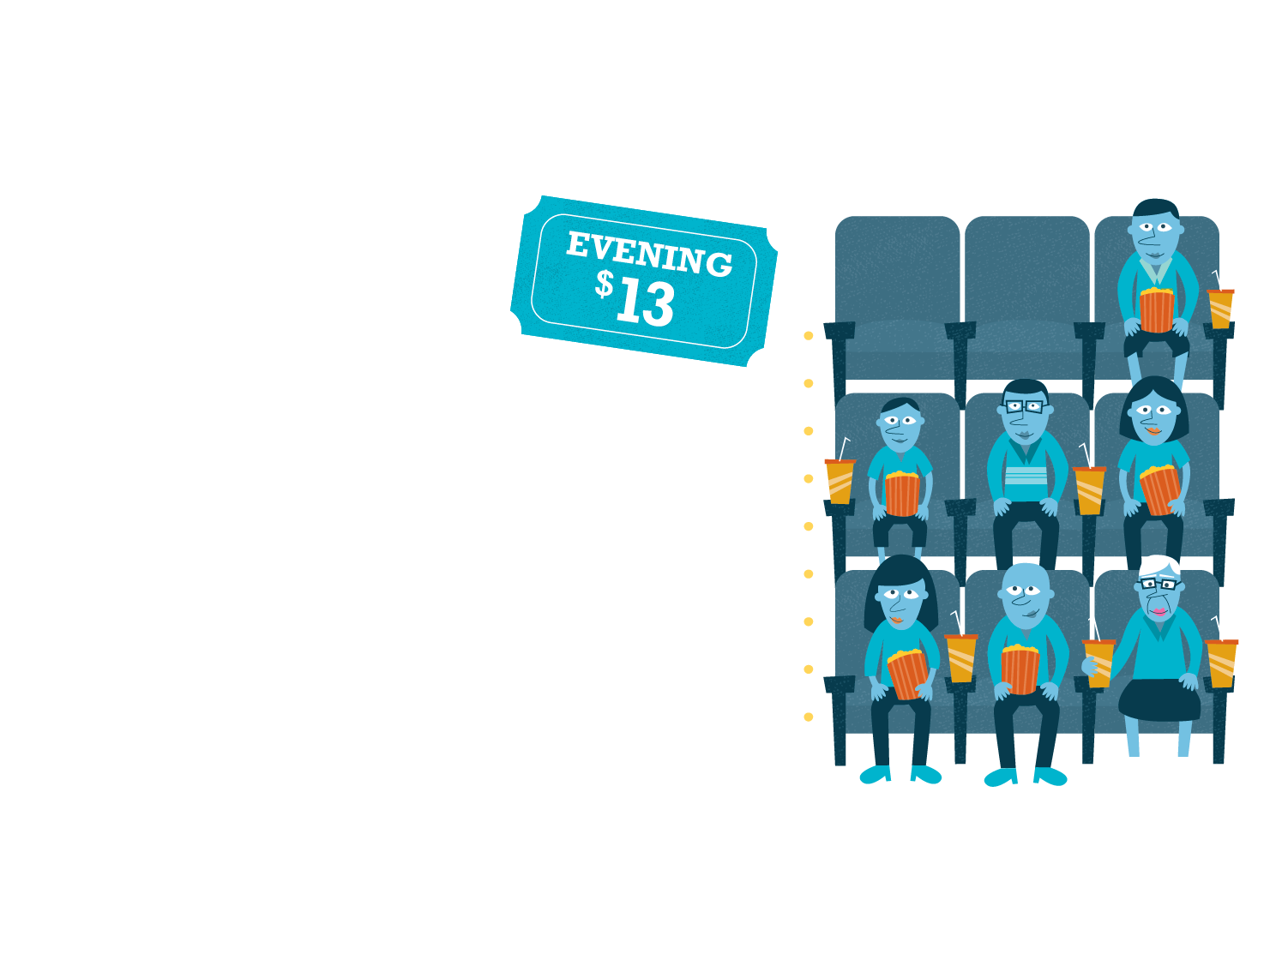
Now Playing: Economics!
SNAPSHOT
Evening movie showings attract larger crowds that consist mainly of adults and couples on dates. This group has relatively inelastic demand, so price is not the determining factor of when and where they see a movie.
The concession counter also generates profit for the movie theater. The high prices mean that patrons who are price conscious (having relatively elastic demand) skip the counter or smuggle in their own snacks, while those who are more concerned about convenience than price (having relatively inelastic demand) buy snacks at the counter.
Notes:
Have you ever gone to the movies early so you could pay less for tickets? Movie theaters price-discriminate based on the time of the movie and the age of the customer. In order to be able to practice price discrimination, theaters must be able to identify different groups of moviegoers, where each group has a different price elasticity of demand.
REVIEW QUESTIONS
Does price discrimination hurt all consumers? Think about the example of movie theaters as you craft your response.
Suppose your local movie theater is thinking about increasing ticket prices for just the opening day of a blockbuster movie. How would you explain the economics behind this price increase to your friends?

Slide 20
Preventing Resale
Having two different prices won't work if the "low" price group can buy at the low price and resell the goods and services to the "high" price group.
This is called arbitrage.
Examples of preventing arbitrage
Airlines require photo ID.
Time-stamped movie tickets
Price discrimination with services rather than goods such as haircuts.
Notes:
A note on the last bullet:
Goods are tangibles and are often easier to resell than services. I can't resell haircuts or trips to the buffet. I can, however, resell shirts, books, and furniture.

Slide 21
Example of Arbitrage
Suppose your university sells a popular magazine publication called "U Magazine."
The magazines are sold to everyone on campus, and the following signs are displayed:
U Magazine
Faculty Price
$2.00
U Magazine
Student Price
$1.00
Notes:
Additional information:
Realize that magazines can easily be resold.
The student would buy many magazines at $1.00 and sell them all to faculty for $1.50. Doing this, he would earn a profit of $0.50 per magazine, and faculty would buy from him to save $0.50 on their purchase.
Slightly more complex:
The student may first have to estimate the faculty demand so he would know how many faculty would be willing to buy the magazines from him at the $1.50 price. He doesn't want to buy too many magazines and be stuck with them.

Slide 22
One Price versus Price Discrimination Third-Degree Price Discrimination
Assume that MC = ATC
Notes:
Flat Earth Air charges the same price to every flyer, while Discriminating Fliers uses two different price structures for its customers. Marginal cost is constant at MC = 100 (horizontal line).
Left:
Flat Earth charges the same price for every seat. This means that the airline charges $300 and serves 100 customers when it sets its price at MR = MC. Since the marginal cost is $100, every passenger who gets on the plane creates $200 in additional profit. The total profit, represented by the green rectangle in the graph, is $200 × 100, or $20,000. At 100 passengers, this airline has done everything it can to maximize profits at a single price. However, there are plenty of unsold seats in the plane that holds 150 passengers. Those unfilled seats represent a lost opportunity to earn additional revenue.
Right:
Discriminating Fliers decides to experiment with two prices: $400 for midweek flights or last minute bookings and $200 for weekend flights and for customers who book in advance. The airline saves 50 seats for the last-minute bookings (impromptu business client meeting), as it cannot sell all the tickets at that high price.
Notice that we don't draw a MR curve on the right! We don't have the simple MR curve derived from the demand function when we price discriminate!
The overall effect of discrimination is more revenue for this airline.
Blue rectangle on upper left: gain since some people now pay higher price ($400 instead of $300).
Blue rectangle on lower right: gain since now more people are buying tickets (an additional 50 tickets are sold at the price of $200 compared to $300).
Red rectangle: by itself, a loss. 50 people would have been willing to pay $300 instead of $200.
Overall, the gains from discriminating in this simple case are bigger than the losses.
In reality, airlines often charge more than two prices. This works well for airlines since tickets cannot be resold.

Slide 23
Graph Summary
Compare a single-price firm to a price-discriminating firm.
With price discrimination:
The most inelastic people pay a higher price.
A lower price is also charged, which will attract more elastic consumers into the market.
The overall amount of sales increases.
Overall, welfare increases and deadweight loss is decreased.
Please see the pdf file in DYS which shows the welfare comparison between competitive firm, monopolistic firm, and monopolistic firm with price discrimination.

Slide 24
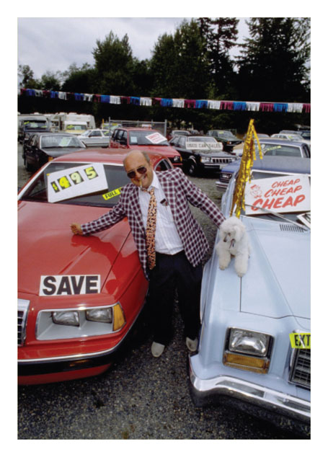
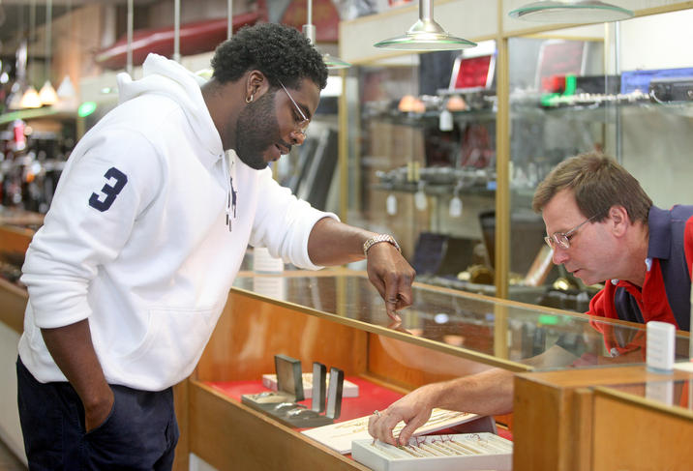
First-Degree (Perfect) Price Discrimination
Perfect Price Discrimination
Firm charges a unique price to each consumer equal to their maximum willingness to pay.
Price = Max Willingness to Pay
If a firm is able to do this, there will be zero consumer surplus. Why?
Hard to implement in real life. Why?
Difficult to know every individual reservation price
Jewelry stores, pawn shops, and car dealerships may attempt to do this with price negotiations.
Notes:
Zero CS: Why?
By definition, CS is the difference between what you are willing to pay and what you actually do pay. If you (and all other consumers) pay exactly what you're willing to pay, then there is no CS.
Jewelry and pawn… Often, these types of stores will have an item price high, but may not necessarily expect someone to just come in and pay the posted price. If your reservation price (price which is equal to the maximum willingness to pay for consumer and minimum willingness to sell for producers) is lower than the original posted price, you can negotiate with the store to lower the price. If the store can successfully negotiate with you (and other consumers) such that everyone pays their reservation price, then perfect price discrimination can occur. Once again though, imperfect information may prevent perfect price discrimination.

Slide 25
Airline Itinerary Prices
Purchase Date | Itinerary Price | Example of Traveler
3 months before flight | $300 | Couple planning vacation. Able to choose cheapest departure day.
2 weeks before flight | $550 | Job interview candidate
2 days before flight | $750 | Businessperson, meeting with client during week. Company paid for flight.
Standby ticket, purchased at any time | $120 | Price-sensitive person with desire to travel and flexible schedule. Undergrad during summertime.
Notes:
Consider the following table. One of the reasons for price differences on airline fares is due to when the fare was purchased.
Question for students:
1.Why does the price rise as the day of the flight draws closer?
Given this table, why doesn't everyone just fly standby?
Answers:
Flights booked far ahead of time could be considered the "discounted" price. People who book that far ahead of time are probably booking a vacation, and exact days may not matter, so they will look for the cheapest days to depart and return. People that book flights closer to the departure date tend to have less advanced notice about the trip they are taking, and are usually more desperate (price inelastic) to take the flight for various reasons (job interview, business meeting, etc). This means the airline can charge that customer a higher price.
A standby ticket, while cheap, doesn't guarantee a seat. Standby tickets are only useful if the plane has empty seats on a flight. Many people aren't flexible enough with their schedules to go to the airport and have a window of eight or more hours to wait for a potential empty seat on a plane.

Slide 26
First-Degree (Perfect) Price Discrimination
Assume that MC = ATC
Notes:
In the case of perfect price discrimination, imagine Perfect Flights just "Walking down the demand curve." Every ticket is sold at a different price! As long as all tickets are sold at a price above or equal to marginal cost, this can be extremely profitable for the firm.
By charging a different fare to every customer, Perfect Flights is also able to increase the number of tickets sold to 200.
The last customer who gets on the plane will be charged an extraordinarily low price of $100—the price you might find in a competitive market. The quantity sold in this outcome also mirrors the result of a government-regulated monopolist who uses the marginal-cost pricing rule, P = MC, to curtail monopoly profits. Perfect Flights is therefore achieving the output efficiency noted in perfect competition while also producing the output a regulated monopolist would make. This provides the firm the opportunity to convert the area consisting of the two blue triangles into more revenue. This process maximizes the quantity sold. The efficiency of the market is improved and the firm generates more revenue.

Slide 27
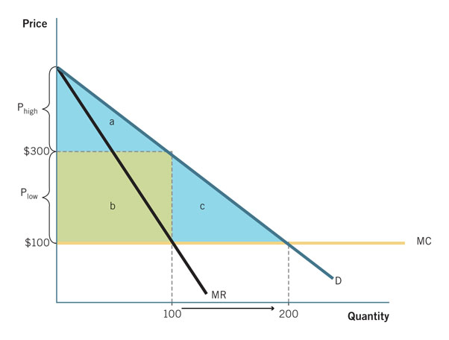
Comparing Market Structures
 | Perfect Competition | Single Price Monopoly | Perfect Price Discrimination
Consumer Surplus | a + b + c | a | 0
Producer Surplus | 0 | b | a + b + c
Deadweight Loss | 0 | c | 0
Total Welfare | a + b + c | a + b | a + b + c
Assume that MC = ATC
Notes:
Perfect price discrimination, while performed by a monopoly, will eliminate DWL. However, it will be very inequitable and may seem "unfair."
Thus, we have a trade-off of efficiency versus equity with perfect price discrimination.
We gain economic efficiency (highest level of output, last unit sold where P = MC).
We also have high inequality. All gains from trade go to the producer. CS = 0.

Slide 28
The Welfare Effects of Price Discrimination
Producers
Have higher PS.
Firms make a higher profit.
Consumers
Benefit from more units being offered for sale since more trading occurs.
Certain cases have higher overall CS.
Overall
Welfare increases and DWL decreases.

Slide 29
Economics in Extreme Couponing
"Extreme Couponing"
Using a coupon is a form of price discrimination.
People that use coupons get the same good at a lower price.
Sales and coupons help distinguish consumer groups.
Are these real?
Notes:
Economics in the media
Lecture tip:
The clip mentioned on the slide can be found in the Interactive Instructor's Guide. Access the direct link by clicking the icon in the PowerPoint above.

Slide 30
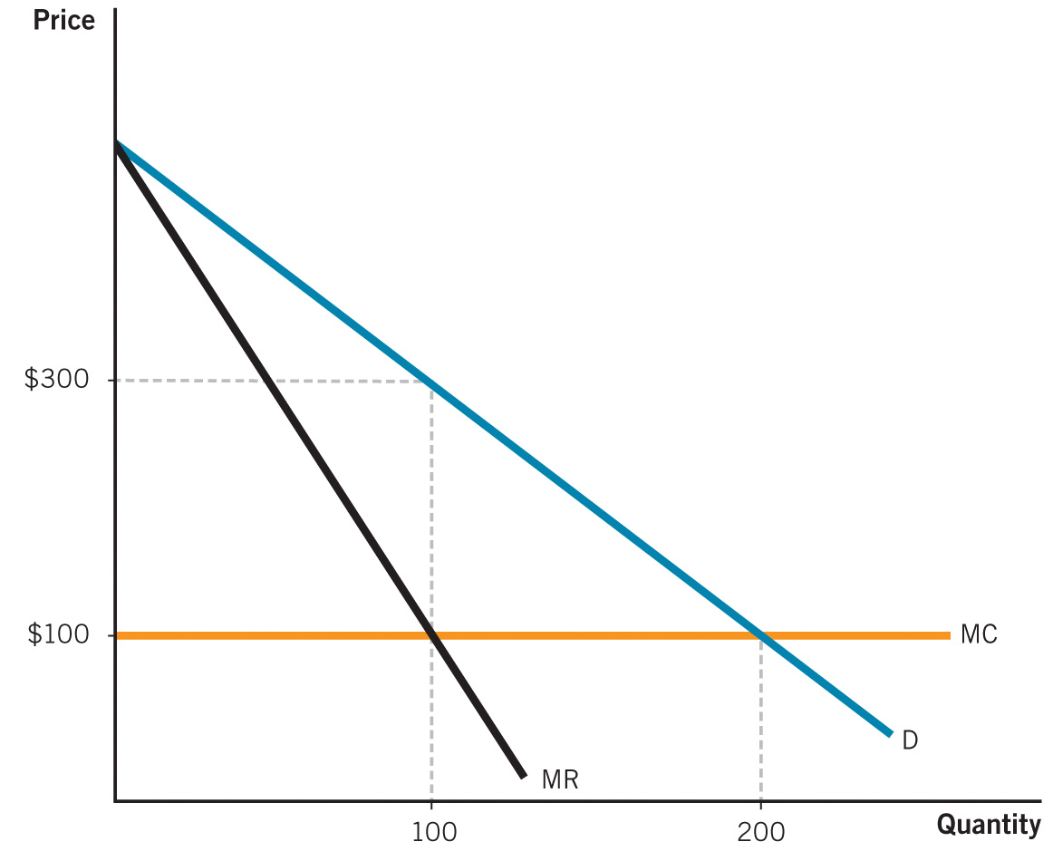
Class Activity: Think-Pair-Share: Welfare Analysis
Use the figure to the right to calculate consumer surplus, producer surplus, and total welfare under:
Perfect competition
Single price monopoly
Perfect price discrimination
Notes:
Classroom activity: Think-Pair-Share: Welfare Analysis
Ask students to get into pairs and solve the problem written out in the slide. Then, discuss in class.
The answer will be revealed on next slide.

Slide 31
Class Activity: Think-Pair-Share: Welfare Analysis
Perfect competition
CS = $40,000
PS = 0
TW = $40,000
2. Monopoly
CS = $10,000
PS = $20,000
TW = $30,000
Notes:
Classroom activity: Think-Pair-Share: Welfare Analysis
Lecture notes:
Perfect Competition:
Consumer surplus is the triangle below the demand curve and above the $100 price = marginal cost:
CS = ½ x ($500 - $400) x 200 = $40,000
Producer surplus is equal to zero since marginal cost is constant.
Total welfare = CS + PS = $0 + $40,000 = $40,000
Monopoly:
Consumer surplus is the triangle below the demand curve and above the monopoly price of $300.
CS = ½ x ($500 - $300) x 100 = $10,000
Producer surplus is the rectangle between the monopoly price and marginal cost.
PS = ($300 - $100) x 100 = $20,000
Total welfare = CS + PS = $10,000 + $20,000 = $30,000
Therefore, the deadweight loss is equal to $10,000.

Slide 32
Class Activity: Think-Pair-Share: Welfare Analysis
Price discrimination
CS = 0
PS = $40,000
TW = $40,000
Notes:
Classroom activity: Think-Pair-Share: Welfare Analysis
Lecture notes:
Consumer surplus is equal to zero since each consumer pays the maximum price he or she is willing to pay.
Producer surplus is the triangle below the demand curve and above marginal cost:
PS = ½ x ($500 - $400) x 200 = $40,000
Total welfare = CS + PS = $0 + $40,000 = $40,000
Note that this is the same total welfare under perfect competition.

Slide 33
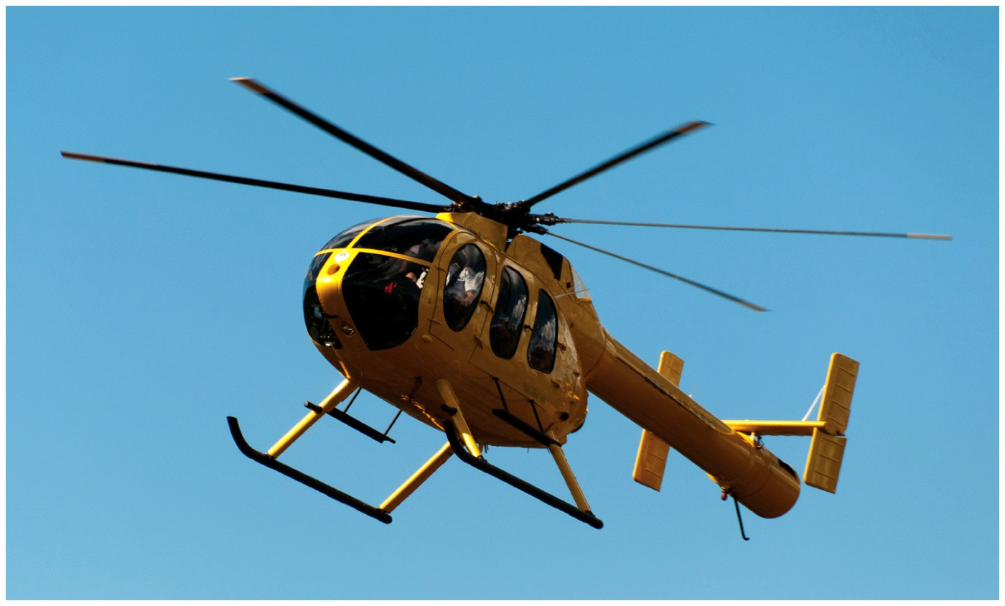
How Much Would You Pay to
Fly in A Helicopter?
Notes:
How much would you pay to fly in a helicopter?

Slide 34
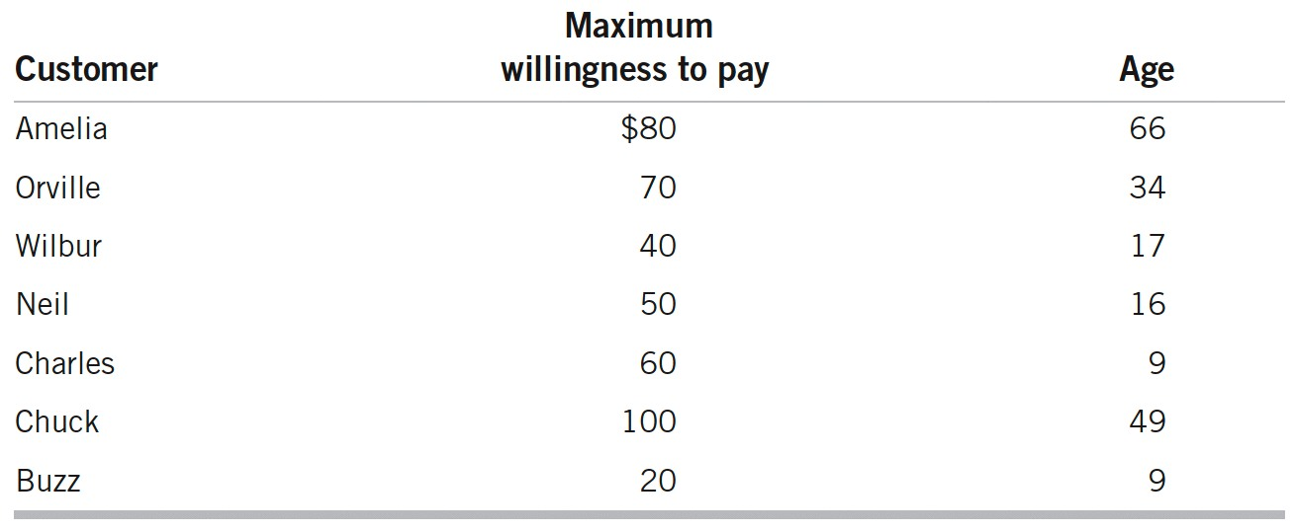
If the company can charge only one price, what should it be?
If the company can charge two prices, what should they be and who should pay them?
Note that marginal cost of taking additional passenger is $10.
If the monopolistic firm is profit-maximizer, what is the total revenue, total cost, and total profit in each case?
Notes:
Price Discrimination: Taking Economics to New Heights

Slide 35
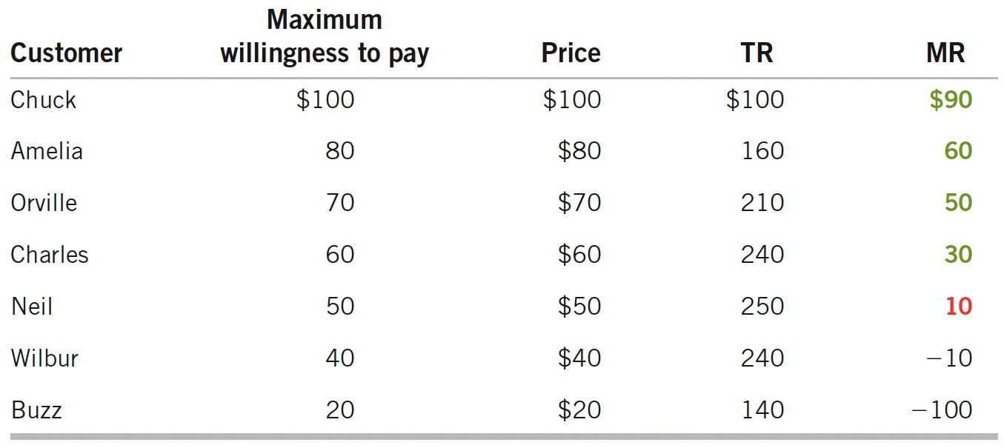
One Price
Order the Maximum Willingness to Pay
$100
What is the profit maximizing quantity?
What is the total revenue, total cost, and total profit?
Notes:
Price Discrimination: Taking Economics to New Heights

Slide 36
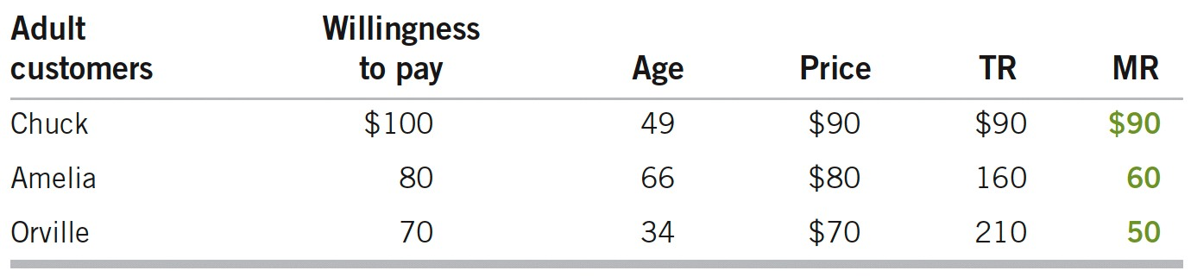
Two Prices
Distinguish the Groups and Order the Maximum Willingness to Pay
$100
$100
$100
What is the profit maximizing quantity for this group?
What is the total revenue, total cost, and total profit for this group?
Notes:
Price Discrimination: Taking Economics to New Heights

Slide 37
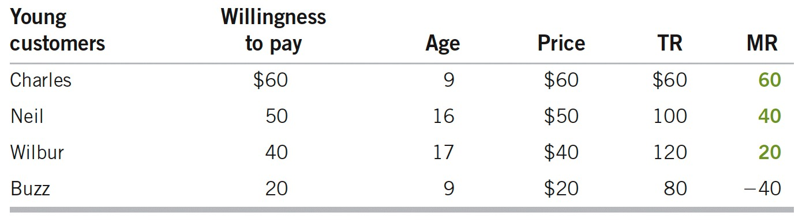
Two Prices
Distinguish the Groups and Order the Maximum Willingness to Pay
What is the profit maximizing quantity for this group?
What is the total revenue, total cost, and total profit this group?
What is the profit maximizing quantity, total revenue, total cost, and total profit for all groups (in total)?
Notes:
Price Discrimination: Taking Economics to New Heights

Slide 38
Price Discrimination at the Movies
What are some ways movie theaters practice price discrimination?
Time of the show
People who can attend afternoon shows (matinee) may be more price elastic due to lower incomes (retired, no job, summer vacation student).
People self-select based on schedule flexibility and price sensitivity.
Age or student status
Children, students, and seniors get discounts, but we all see the same movie!
Income and "tastes and preferences" may decrease demand among very old or very young moviegoers.
Notes:
Now we begin a list of real-world cases of price discrimination.
Time:
Theaters discount matinee prices to encourage movie goers who have elastic demand and are willing to watch at a less crowded time. Movie theaters are also willing to discount the price of matinee shows since they pay to rent films on a weekly basis, so it is in their interest to show a film as many times as possible. Since the variable cost of being open during the day is essentially limited to paying a few employees the minimum wage, the theater can make additional profits even with a relatively small audience.
Age:
Age-based price discrimination does not always work perfectly. Theaters do not usually ask for proof of age, and it may be hard to tell the difference between a child who is just under 12 and one who is over 12. However, the process of price discrimination works well enough to make age a useful revenue-generating tool.

Slide 39
Price Discrimination at the Movies
Concession pricing
Price inelastic consumers
Will eat theater snacks, willing to pay high price
Price elastic consumers
Will not eat theater snacks or will smuggle in their own food
Which customers does the theater want?
It wants both of them in the seats watching the movie. Empty seats are lost revenue.
Notes:
Theaters often limit outside food and drinks. Having said that, movie theaters push people with inelastic demand for snacks to buy from the concession area. Of course, that does not stop some customers with elastic demand from sneaking food into the theater.
As long as some moviegoers are willing to buy concession fare at exorbitant prices, the theater will generate more revenue. Movie theaters cannot prevent smuggling completely, but they don't have to. All they really want to do is separate their customers into two groups: a price-inelastic group of concession area snackers and a price-elastic group of nonsnackers and smugglers who fill up the remaining empty seats in the theaters.
Empty seats represent lost revenue so it makes sense to try to price discriminate through a combination of high and low prices.

Slide 40
Price Discrimination on Campus
Tuition
FAFSA lowers tuition costs for qualifying students.
In-state students pay less tuition.
Parents have been paying state taxes for many years already.
Out-of-state students pay more in tuition.
Perhaps more inelastic, really like the school more than another local school.
Private colleges
Set a high starting price, then discount as necessary to gain enrollment and maximize revenues.
Notes:
FAFSA = Free Application for Federal Student Aid. This separates college students based on income.
In-state versus out-of-state:
Out of state students pay more for two reasons:
Parents haven't been paying taxes in THIS state to support university (assuming it's a public university).
If you are willing to go out of state, you must really value this university over others, and are willing to pay more for it.
Private schools:
Private colleges also discriminate by advertising annual tuition and room and board fees that often exceed $50,000. With price discrimination, the "sticker" price is often discounted. Depending on how much the college wants to encourage a student to attend, it can discount the tuition all the way to zero. Scholarships and financial need go to those who require it to attend the school, but there are still placements for the children of wealthy alums and others willing and able to pay the full sticker price.

Slide 41
Price Discrimination on Campus
Student discounts
Bars, restaurants, shops, software, among others often give student discounts in college towns.
Student discounts are a way to increase a firm's customer base and get students in the door to purchase goods.
Nonstudent consumers are charged more.
What is the main reason?
Students often have lower income and are much more price elastic.
Notes:
How are these student discounts enforced?
Most of the time, vendors will ask to see a student ID before applying a discount.
More-advanced student IDs can contain digital personal information and even act as a debit card. If a student pays for the goods or services with an ID, a discount is automatically applied.

Slide 42
Practice What You Know Price Discrimination
Look at each of the following situations. Are they examples of price discrimination?
Yes: cheer
No: boo

Slide 43
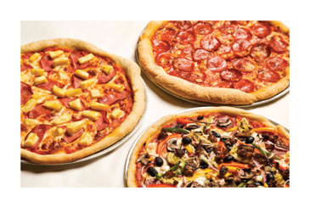
Practice What You Know Price Discrimination
At Little Nero's Pizza, the menu lists the following prices:
Cheese pizza = $8
Supreme pizza = $11
Price discrimination?
Yes: cheer
No: boo
NOT price discrimination.
The price differences exist in part due to cost of production differences.

Slide 44
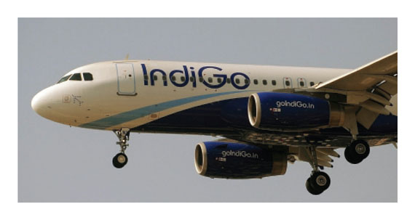
Practice What You Know Price Discrimination
Lee buys an economy-class airline ticket for $100 and Dirk buys a first-class ticket for $200.
Price discrimination?
Yes: cheer
No: boo
NOT price discrimination.
Dirk may get extra drinks and food, which are additional costs to the airline.

Slide 45
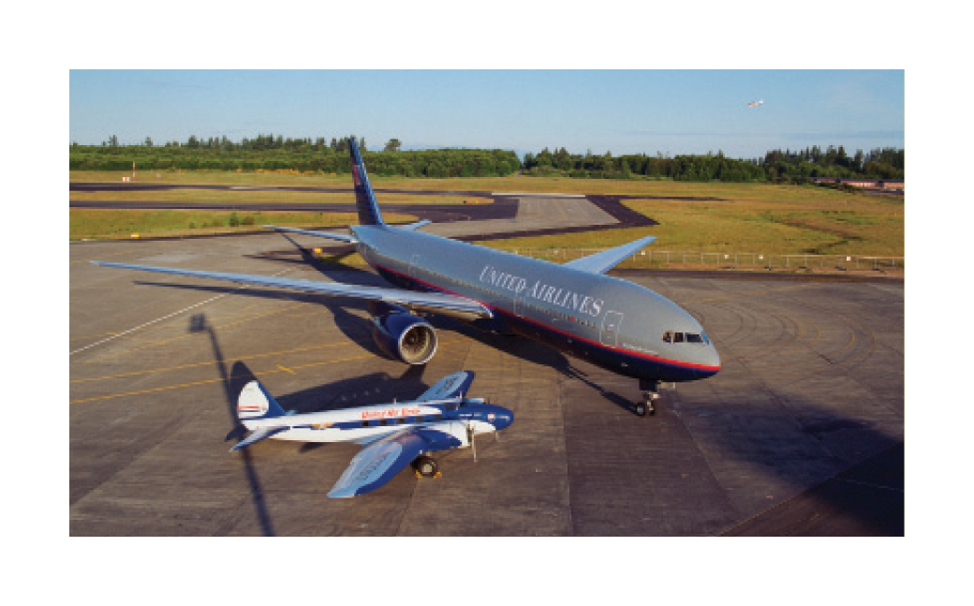
Practice What You Know Price Discrimination
Lee and Dirk both buy an economy-class ticket on the same flight. Lee pays $83 less than Dirk because he booked two weeks earlier.
Price discrimination?
Yes: cheer
No: boo
YES, price discrimination.
The product is the same, and the price difference has nothing to do with cost differences.

Slide 46

Practice What You Know Price Discrimination
Jaime gets her oil changed at Cars N' Stuff for $30 and Katie gets her oil changed at Automobiles Incorporated for $25.
Price discrimination?
Yes: cheer
No: boo
NOT price discrimination.
Two firms offering different products. May be quality and cost differences.

Slide 47
Practice What You Know Price Discrimination
Joe and Sheila each buy a ticket to the ballet and sit together. Joe paid $5 less than Sheila because of a student discount.
Price discrimination?
Yes: cheer
No: boo
YES, price discrimination.
The product is the same, and the price difference has nothing to do with cost differences.

Slide 48
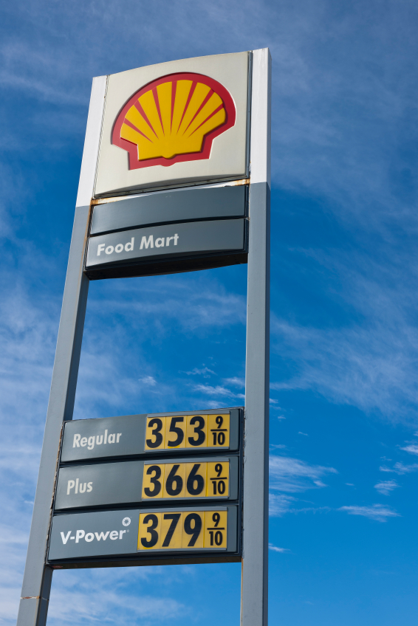
Practice What You Know Price Discrimination
Lincoln, Nebraska gas price = $3.49 Austin, Texas gas price = $3.79
Price discrimination?
Yes: cheer
No: boo
NOT price discrimination.
Cost may be higher to get gas to Austin. In addition, two different firms are selling the product.

Slide 49
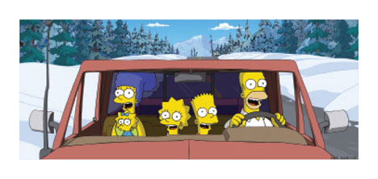
Practice What You Know Price Discrimination
Bart and Lisa go to a club. Bart has to pay a cover charge for entry, but Lisa gets in for free due to a "Ladies' Night" special.
Price discrimination?
Yes: cheer
No: boo
YES, price discrimination.
The product is the same, and the price difference has nothing to do with cost differences.

Slide 50
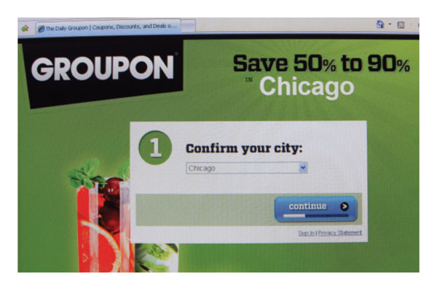
Practice What You Know Price Discrimination
Mark and JoAnn each buy one box of cereal at the local grocery store. JoAnn gets a $1.00 discount by using a coupon.
Price discrimination?
Yes: cheer
No: boo
YES, price discrimination.
The product is the same, and the price difference has nothing to do with cost differences.
Notes:
JoAnn has revealed her sensitivity to price by searching for a coupon, and waiting to buy the cereal until a coupon is available.

Slide 51
Conclusion
Price discrimination helps us see how many markets function since instances of perfect competition and monopoly are rare.
Price discrimination general rule:
Charge higher price to relatively inelastic consumer group
Charge lower price to relatively elastic group
Results of price discrimination
Increasing social welfare
Decreasing deadweight loss
Creates a more efficient outcome
Notes:
Recall some often-seen examples of price discrimination here:
Student discounts, military discounts, senior citizen discounts, movie matinees, airline tickets.

Slide 52
Summary
A firm must have some market power before it can charge more than one price.
Price discrimination occurs when:
Firms have downward-sloping demand curves.
Firms can identify different groups of customers with varying price elasticities of demand.
Firms have the ability to prevent resale among their customers.
Notes:
Some market power means that the firm must face a downward-sloping demand curve.

Slide 53
Summary
Under price discrimination
Some consumers pay a higher price
Others are given a discount.
Price discrimination
Is profitable for the firm.
Reduces deadweight loss.
Helps to restore a higher output level.
Notes:
While "discrimination" often has a negative connotation, price discrimination is actually good in the sense that it improves overall economic welfare. This is due to the reduction of deadweight loss and the increased number of trades resulting from charging different prices.

Slide 54
Practice What You Know
Which of the following goods or services is most likely to be sold successfully by a firm at different prices?
Economics textbooks
Haircuts
Candy bars
University apparel
Notes:
Correct answer: B
The key here is arbitrage.
Books, candy bars, and clothing can all be easily resold. A haircut is a service and can't be resold. I can't get a haircut and resell it to you.

Slide 55
Practice What You Know
Dirk buys chicken nuggets. Lee buys chicken parmesan. The two men pay two different prices for these goods. This is an example of ______.
demand shifting
inelastic demand
price discrimination
none of the above
Notes:
Correct answer: D
While the goods are different in price, there are COST DIFFERENCES in their production. This is NOT price discrimination.

Slide 56
Practice What You Know
A general rule for price discriminating with two consumers groups is to charge a ______ price to the inelastic group and to charge a ______ price to the elastic group.
high; low
low; high
positive; negative
negative; positive
Notes:
Correct answer: A
Charge the relatively higher price to the relative insensitive (inelastic) consumer group!

Slide 57
Practice What You Know
What market and pricing structure has the least amount of consumer surplus?
Perfect competition
Pure monopoly (single price)
A price discriminating monopoly that charges two different prices
A monopolist that engages in perfect price discrimination
Notes:
Correct answer: D
Be careful again here:
Just because perfect price discrimination has zero CS, doesn't mean it's inefficient. Perfect price discrimination is actually efficient in the sense that it has no DWL, but it is very inequitable since all the surplus goes to producers.

Slide 58
Practice What You Know
Why might one consumer group (A) have a more elastic demand (and be more price sensitive) than another group (B) of consumers?
Group (A) may have less income.
Group (A) may have lower tastes and preferences for the good.
Both of the above could be true.
None of the above
Notes:
Correct answer: C
A number of factors can affect an individual's willingness to pay for a good.

Slide 59
Sources
"Principles of Economics with Smartwork Access (ISBN: 978-0-26314-5), 1st Edition, 2013" by Mateer and Coppock
"Economics: Custom Edition for NCSU (ISBN: 9781937435202" by David Hyman

